Slide 1
Desk Pilots: Navigating a Healthy Flight Plan for Your Posture and Well-being
Faisal Hussain

Slide 2

Feedback:

Slide 3
Agenda
Motivation for the talk
Main causes of desk injuries
The perfect desk set up
Practical tips & exercises

Slide 4





A Bit About Me
Notes:
Faisal Hussain
Work for Adatis.
26 years old and spend most of my working life at a desk.
Not a health professional.
Advice is based on my own findings and journey so far.

Slide 5
Main Issues and Root Causes
Facts:
85% of people
£1,000,000,000
80,000 hours
Notes:
80,000 hours spent at a desk.
85% of people have experienced some form of occupational health complaint.
Billions of pounds spent annually on treatments for these issues.

Slide 6
Main Issues and Root Causes
Main Issues:
1. Musculoskeletal Disorders
2. Eye Strain and Fatigue
3. Repetitive Strain Injuries (RSI)
Notes:
1. Musculoskeletal Disorders:
Examples include back pain, neck strain, and carpal tunnel syndrome.
2. Eye Strain and Fatigue:
Staring at screens for extended periods can lead to digital eye strain.
Inadequate lighting and improper screen positioning exacerbate the problem.
3. Repetitive Strain Injuries (RSI):
Typing and mouse usage can cause RSIs.

Slide 7
Main Issues and Root Causes
Root Causes:
1. Sedentary Lifestyle
2. Poor Ergonomics
3. Lack of Awareness
Notes:
1. Sedentary Lifestyle:
Extended periods of sitting reduce blood flow, leading to various health issues.
2. Poor Ergonomics:
Inadequate desk setup and chair design contribute to musculoskeletal problems.
3. Lack of Awareness:
Many individuals are unaware of proper posture and the importance of breaks.

Slide 8
The Perfect Desk Setup
Ergonomics:
The study of people's efficiency in their working environment.
Good Desk Setup:
Aligns with the natural human body movements.

Slide 9
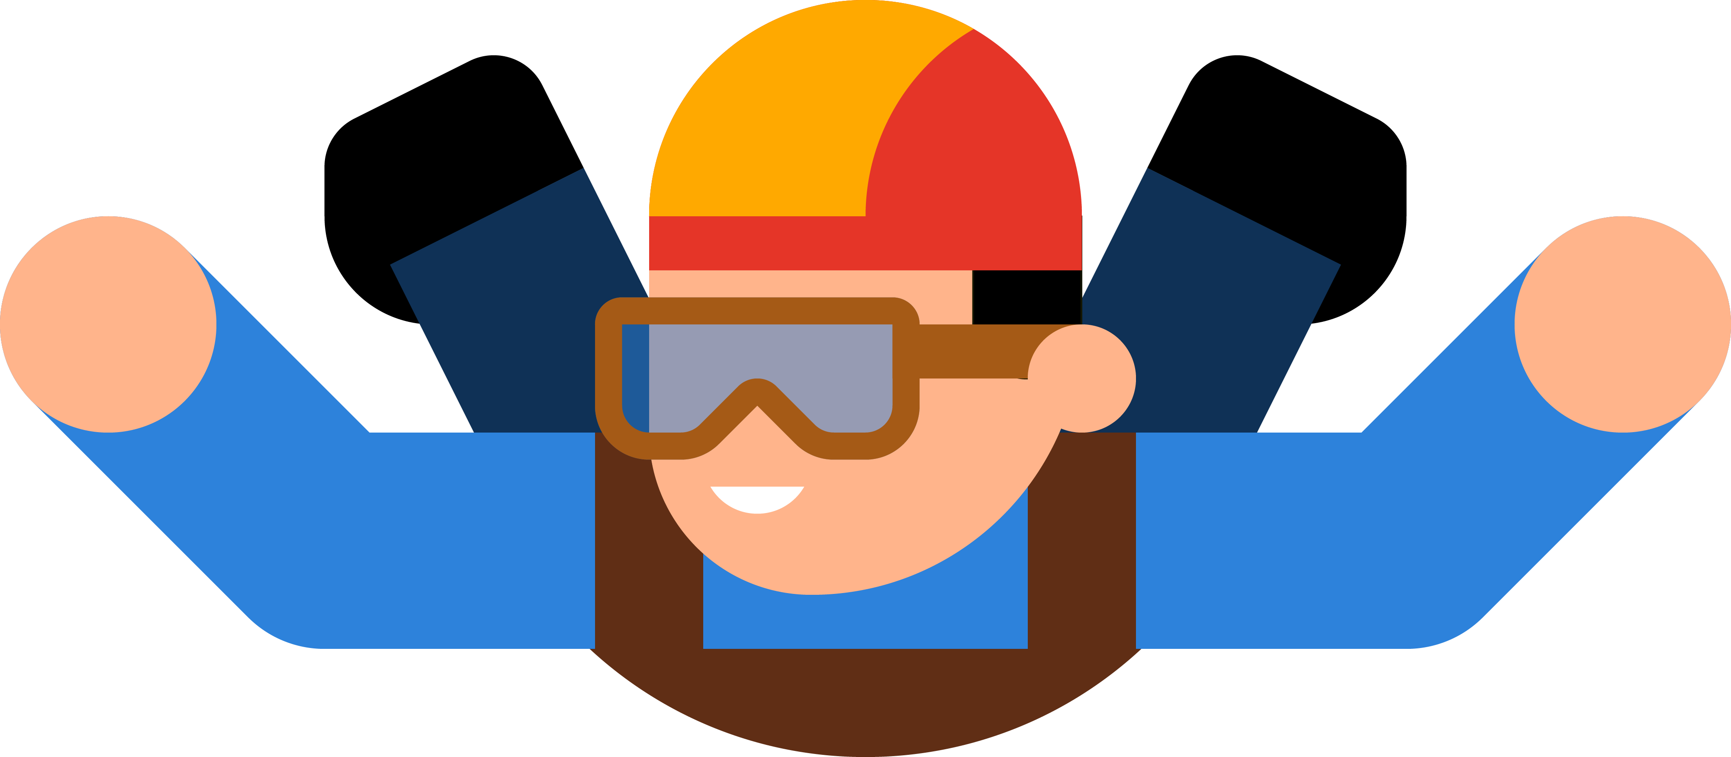
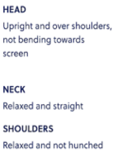
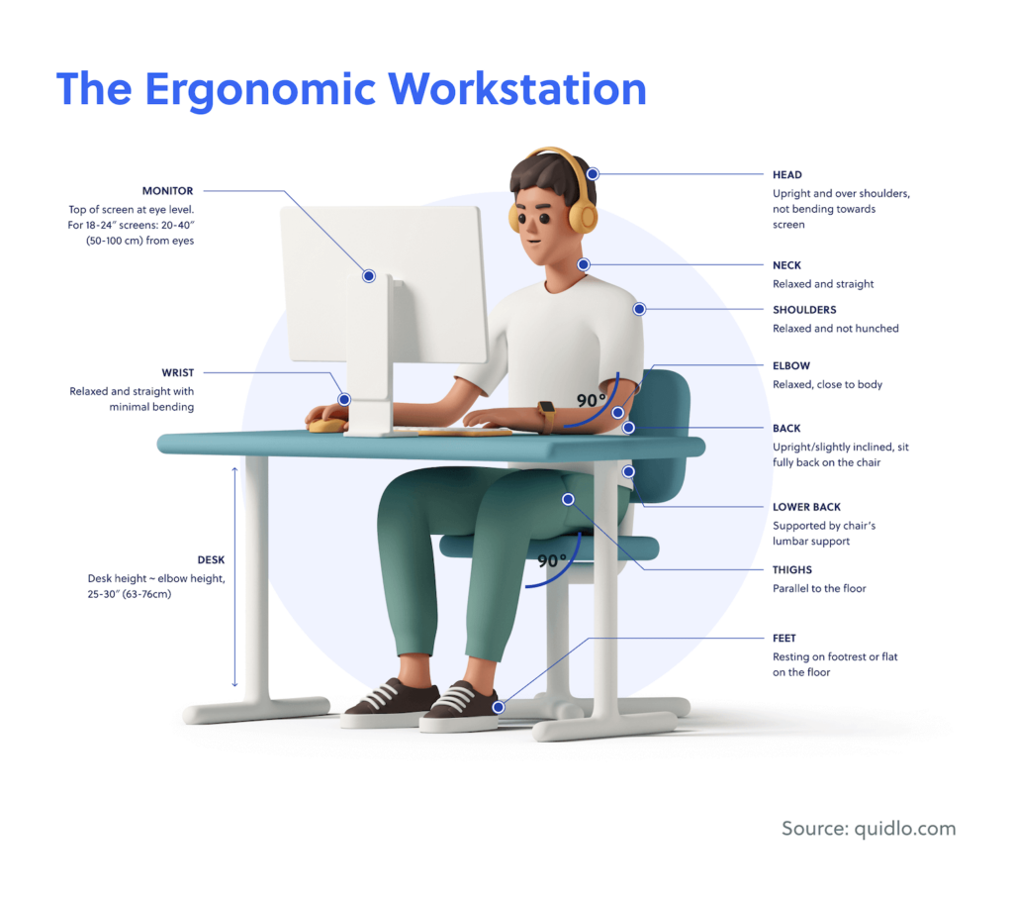










The Perfect Desk Setup

Slide 10
The Perfect Desk Setup
Other Considerations…
Screen Brightness and Glare
Lighting
Notes:
Screen Brightness and Glare
Adjust screen brightness to reduce eye strain.
Minimise glare by placing the monitor perpendicular to windows and using anti-glare screens.
Lighting
Ensure proper lighting to reduce eye strain.
Use a combination of natural and artificial light to illuminate the workspace evenly.

Slide 11
Practical Exercises and Tips
Would you run a marathon without warming up?
Warm-Up Exercises
1. Neck Stretches
2. Shoulder Rolls
3. Wrist Circles
Notes:
1. Neck Stretches:
Gently tilt your head from side to side, forward and backward.
Repeat each movement 5-10 times to release tension.
2. Shoulder Rolls:
Roll your shoulders backward in circular motions.
Switch directions after 10 rolls to loosen up the shoulder muscles.
3. Wrist Circles:
Rotate your wrists clockwise and then counterclockwise.
This helps to prevent strain from prolonged keyboard use.

Slide 12
Practical Exercises and Tips
Set 55 Minute Breaks:
1. Get Moving
2. Eye Exercises
3. Deep Breathing
If On A Call:
1. Pace Around
2. Leg Lifts

Slide 13
Practical Exercises and Tips
Would you finish a marathon without cooling off?
Post-Work Exercises
1. Seated Spinal Twist
2. Forward Fold
3. Chest Opener
Notes:
1. Seated Spinal Twist:
Sit on the edge of your chair and twist your upper body to one side.
Hold for 15 seconds on each side to relieve lower back tension.
2. Forward Fold:
While seated or standing, bend at the waist and reach for your toes. Hold for 20 seconds.
3. Child’s Pose:
Kneel on the floor and stretch your arms forward.
Hold for 30 seconds to stretch your back and shoulders.
4. Chest Opener:
Clasp your hands behind your back, straighten your arms, and lift your chest. Hold for 15 seconds.

Slide 14


Thank you!
LinkedIn:
https://www.linkedin.com/in/faisal-hussain20/
Email:
faisal.hussain@adatis.co.uk

Slide 15


